Slide 1
CMP3004 | Formal Languages & Automata Theory Term Project Travelling Salesman Problem Spring 2021
Computer Engineering
Batuhan Aydın
Velid Nazari
E. Burak Tokman

Slide 2
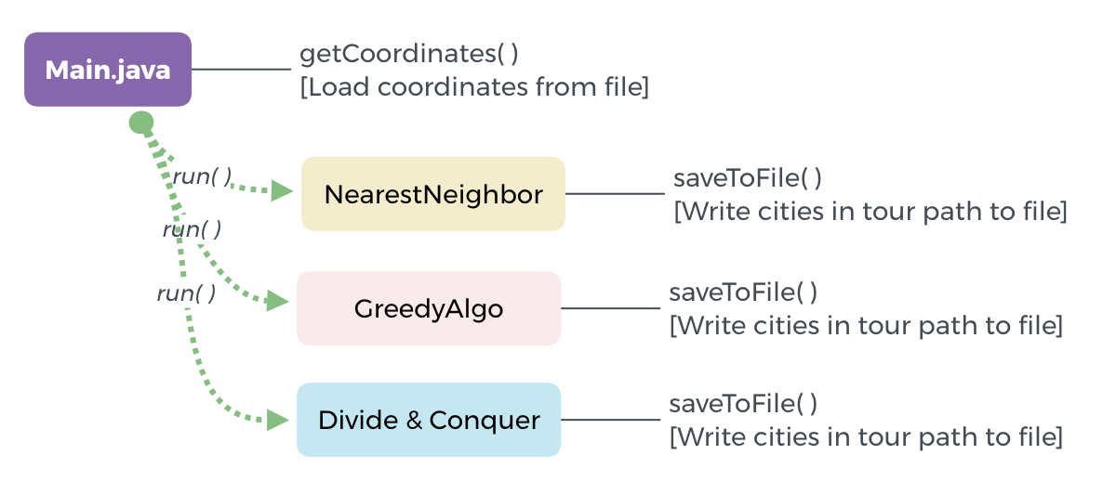
1. Program Design

Slide 3
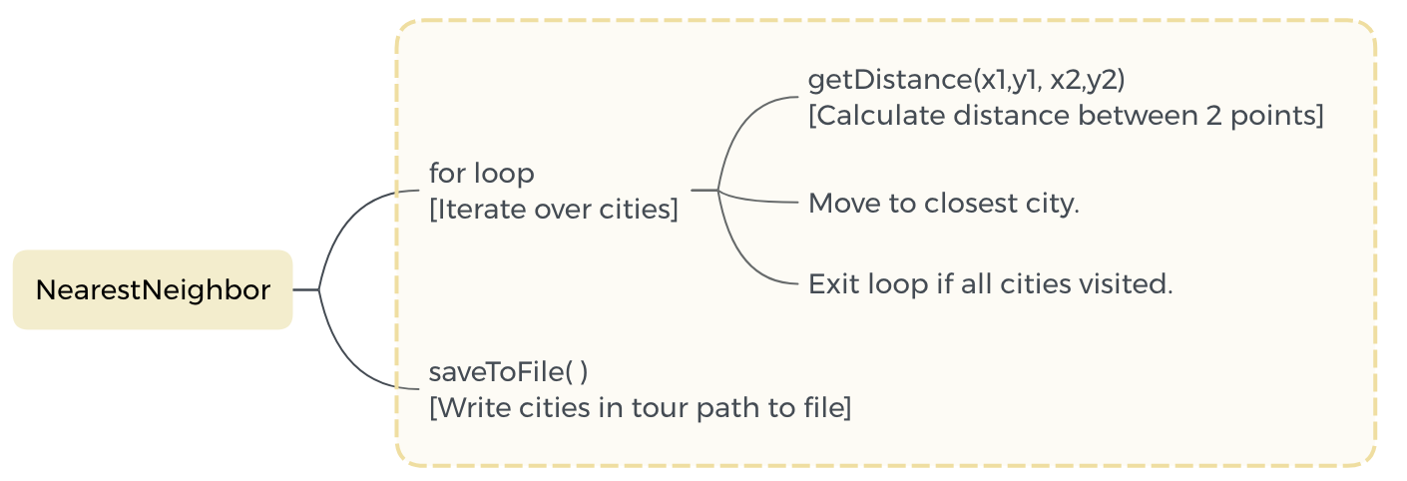
2. Nearest Neighbor
Workflow:
1. Select the first city in .tsp file as starting city.
2. Calculate the distance between current city and unvisited cities.
3. Move to closest city.
4. Repeat until all cities visited.
5. Move back to starting city.

Slide 4
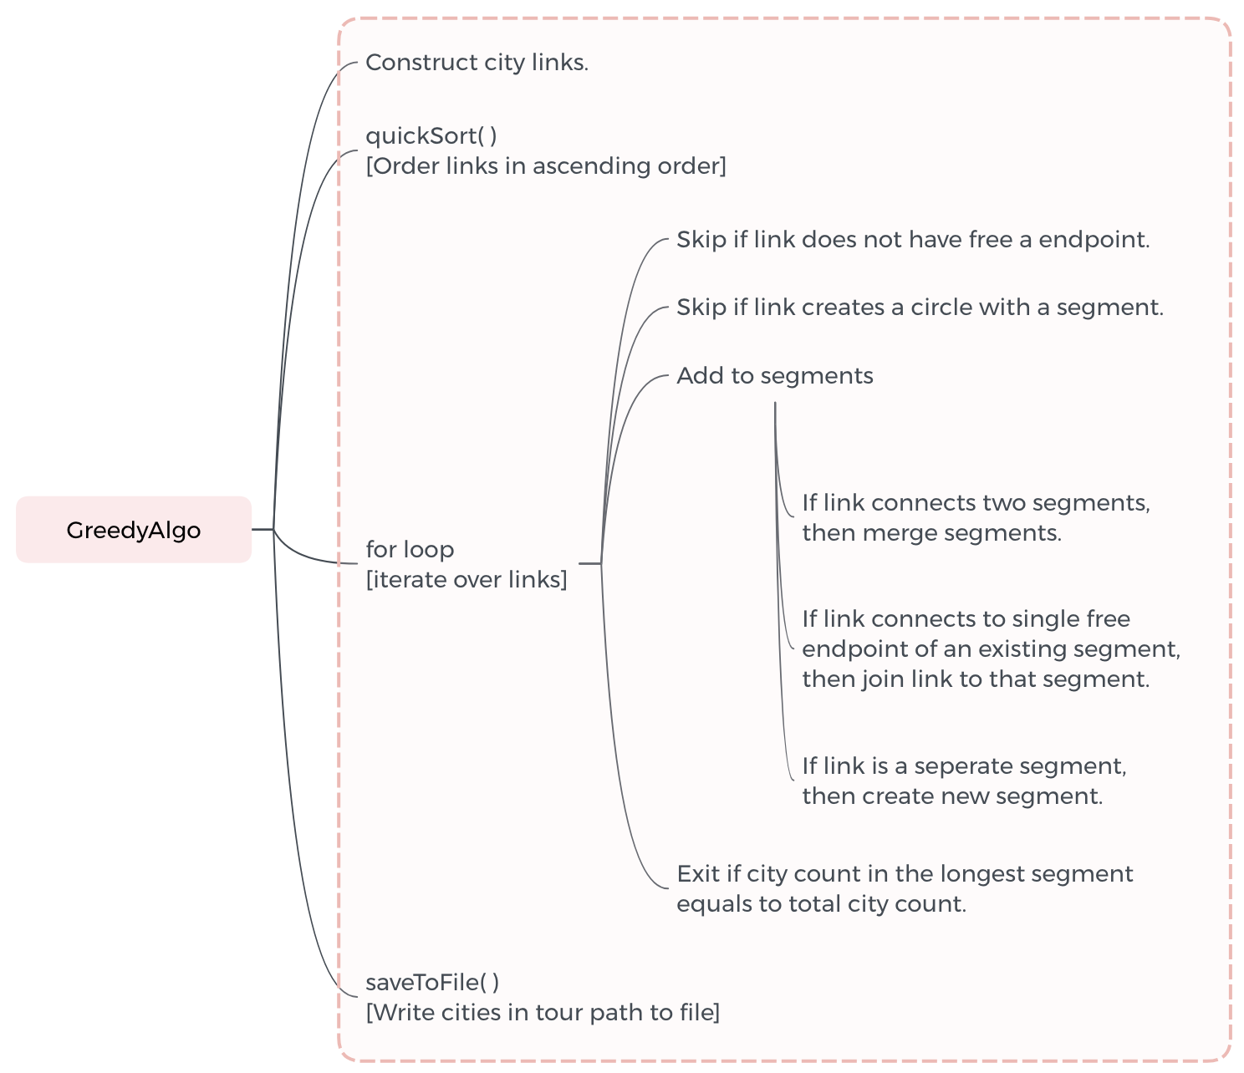


3. Greedy Algorithm
Selected new link creates four possibilities:
1. Create a standalone segment.
2. Connect to a free endpoint of an existing segment.
3. Join 2 segments into a single segment.
4. Allow to create cycle if all cities visited

